Slide 1

Digital Signal Processing
Section 6
Convolution
Asmaa fathy

Slide 2
What is Convolution ?
Convolution is a mathematical process used in signal processing and engineering mathematics.
In the context of signal processing, this is used for many purposes such as applying filters and analyzing signals.

Slide 3
USE CONVOLUTION
Naturally, Here are some practical examples of how the Convolution Process has been used in various fields:
Applying filters in image processing:
In image processing, convolution is used to apply filters to images to enhance or modify them. For example, the Sharpening Filter uses convolution to improve image sharpness.
Use in Neural Networks:
In machine learning, convolution is widely used in neural networks, especially in image analysis and shape recognition. It is used to extract features from images and identify patterns.
Audio signal processing:
In signal processing, convolution is used to apply filters to audio signals, enabling noise to be removed or quality improved.

Slide 4
Methods To Compute The Convolution Sum of Two Sequences x(n) And h(n)

Slide 5
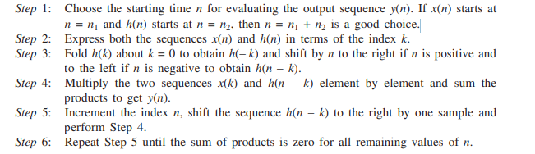
Method 1 Linear Convolution Using Graphical Method

Slide 6
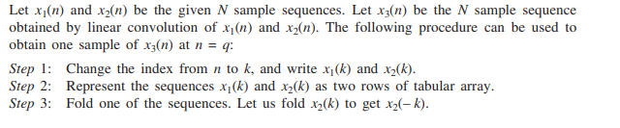
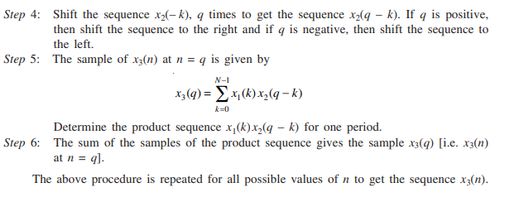
Method 2 Linear Convolution Using Tabular Array

Slide 7
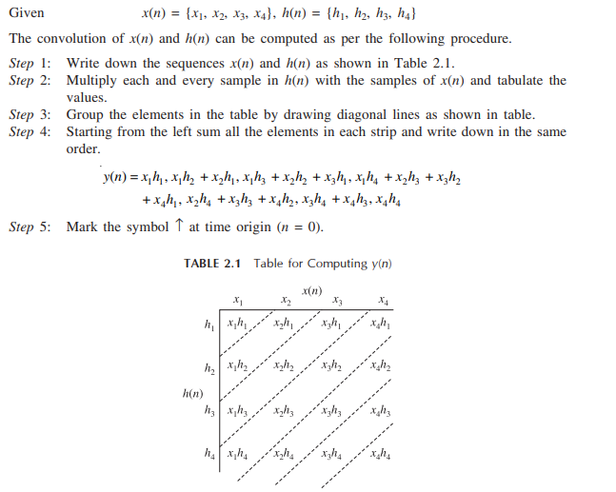
Method 3 Linear Convolution Using Tabular Method

Slide 8
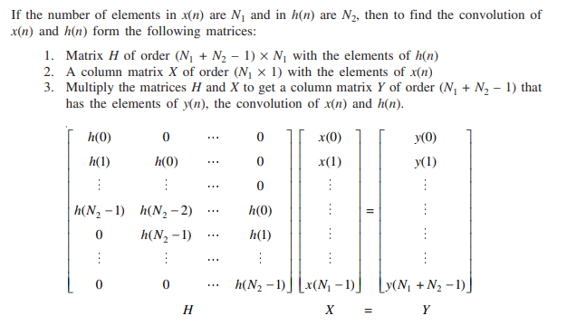
Method 4 Linear Convolution Using Matrices

Slide 9
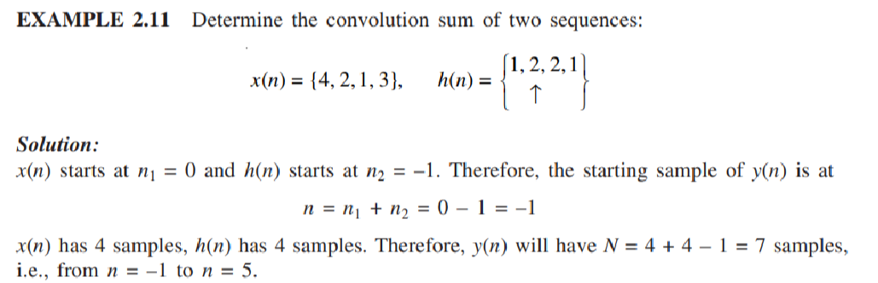

Slide 10
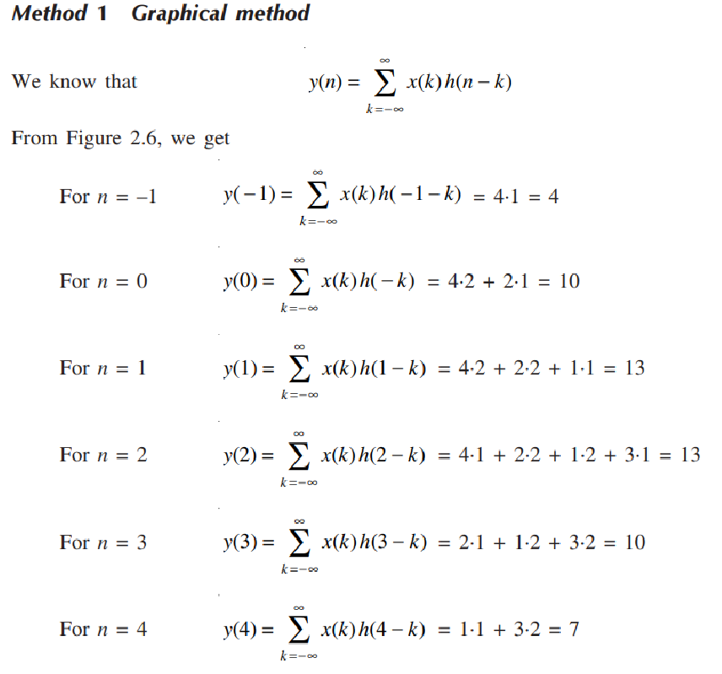
Method 1 Graphical Method

Slide 11
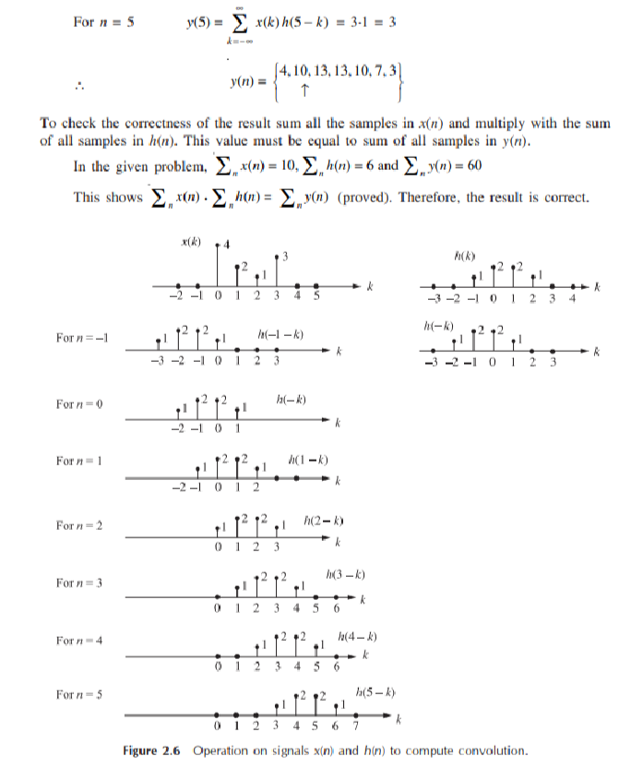

Slide 12
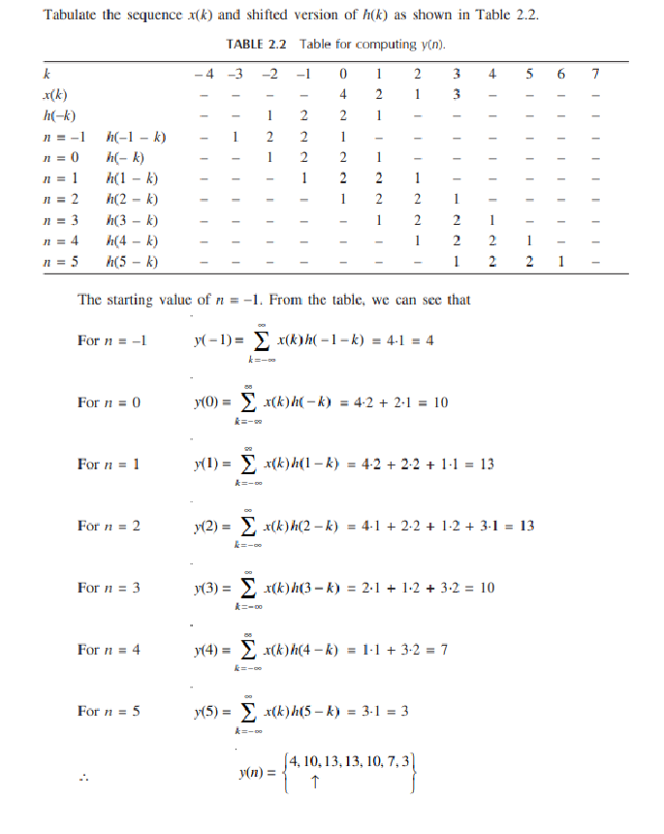
Method 2 Tabular Array

Slide 13
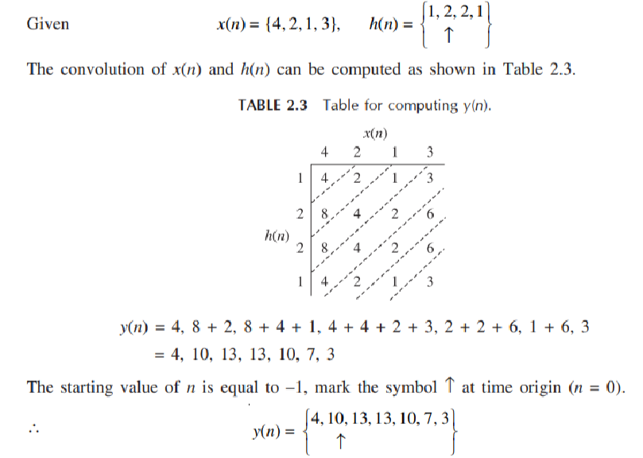
Method 3 Tabular Method

Slide 14
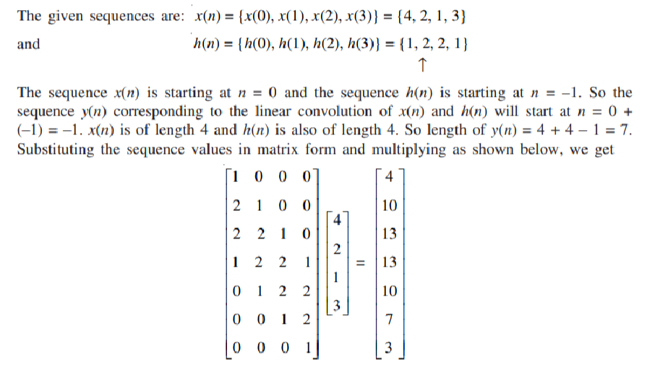

Method 4 Matrices Method

Slide 15
Thank You

